Slide 1
Amazon E-COMMERCE customer reviews analysis – a python project
By Ali A. Nathani
February 22, 2020

Slide 2
Presentation Outline
Background/Introduction & Objectives
Research Question/Hypothesis
Methodology/Inclusion/Exclusion/Definition
Data Exploration & Data Cleaning
Uni/Bi/Multi variate Analysis
Fix Missing Values
Transform Variables
Feature Engineering
Model Building
Conclusions
Recommendations

Slide 3
Background/Introduction
About this Dataset
This is a pre-crawled dataset, of 15,000 records, taken as subset of a bigger dataset (more than 7 million fashion products) that was created by extracting data from Amazon.
Background
This dataset was created by PromptCloud's in-house web-crawling service.
Objectives
Analyses of the ratings, category and reviews can be performed.

Slide 4
Research Question(s)/Hypothesis(es)
Research Questions / Problem Statement
Can the expected review rating of a product, be possibly determined from the category, manufacturer, number of reviews and the number of answered questions?
Hypothesis
The Hypothesis would be that review rating can be determined from the category, manufacturer and number of reviews.

Slide 5
Methodology/Inclusion/Exclusion/ Definition
Main Steps
The Data Step – Import /Connect the DataSet
Data Exploration
Data Cleaning
Feature Engineering
Model Building
The Data Step – Import /Connect the DataSet
Using Python Jupyter Notebook

Slide 6
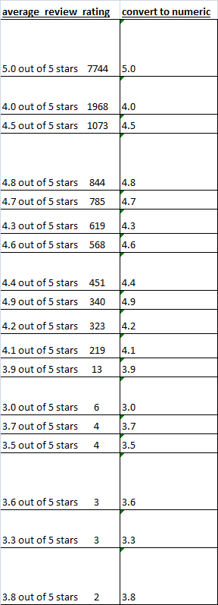
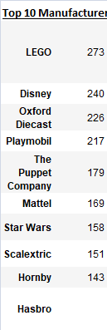
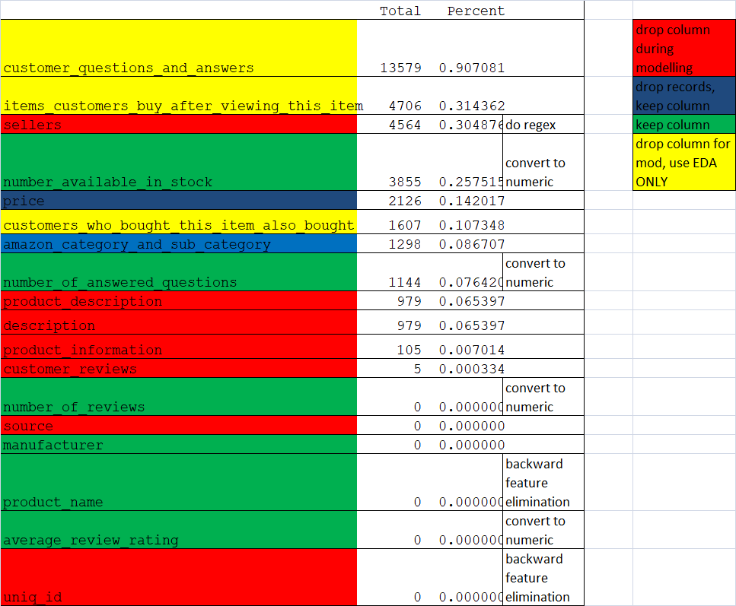
Data Exploration & Data Cleaning
Top records
Missing Values

Slide 7
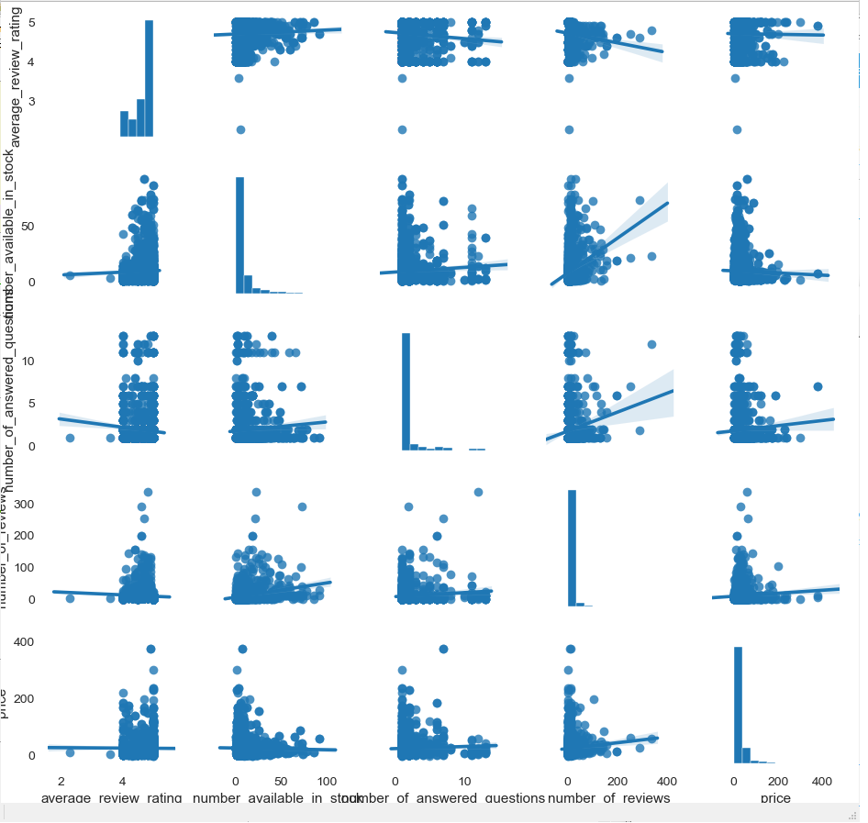
Data Exploration & Data Cleaning
PAIR PLOT
The plot shows that there is a lack of correlation between the chosen variables after cleaning

Slide 8
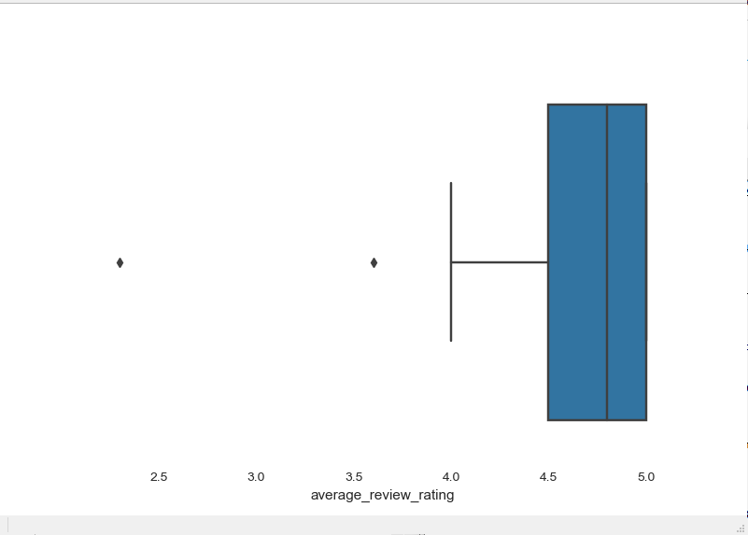
Data Exploration & Data Cleaning
Univariate Analysis
Distribution of:
average_review_rating
Majority of the results are between 3.5 to 5

Slide 9
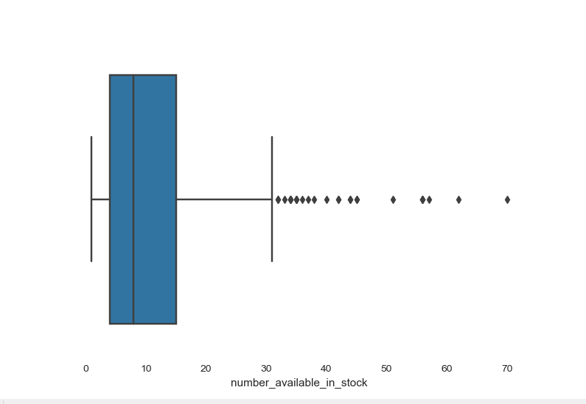
Data Exploration & Data Cleaning
number_available_in_stock
Results are between 1 and 70

Slide 10
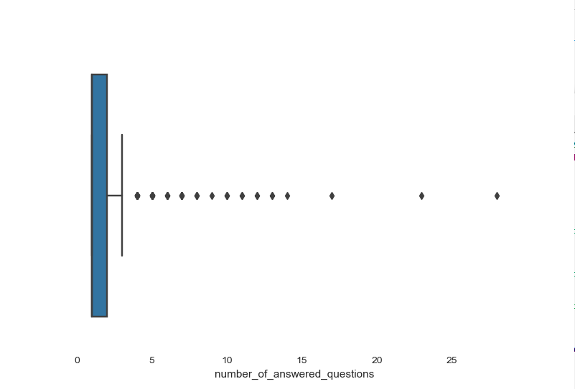
Data Exploration & Data Cleaning
number_of_answered_questions
Results are between 1 and 28

Slide 11
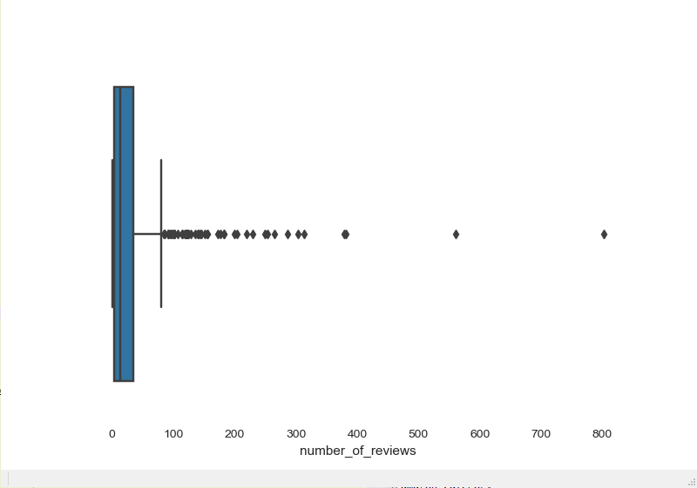
Data Exploration & Data Cleaning
Number_of_reviews
Results are between 1 and 802

Slide 12
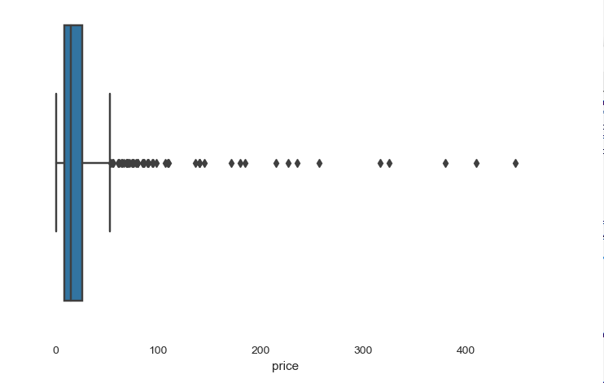
Data Exploration & Data Cleaning
Price
Results are between 0.6 and 447.99

Slide 13
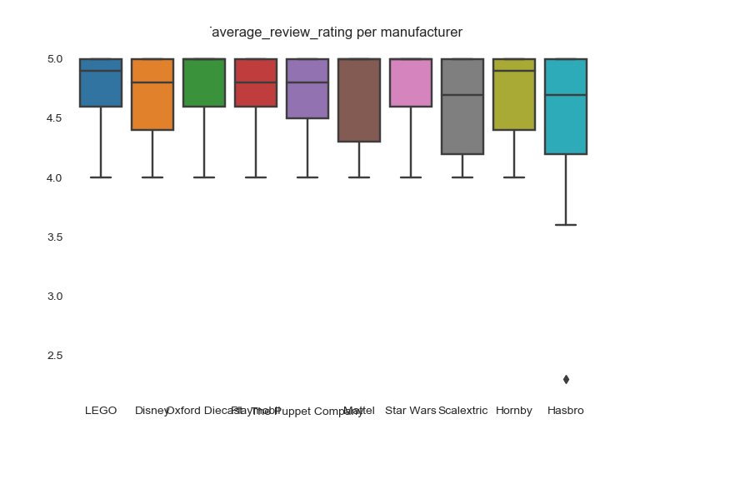
Data Exploration & Data Cleaning
Bivariate Analysis
Distribution of average_review_rating per manufacturer
Majority of the results are between 4.5 to 5

Slide 14
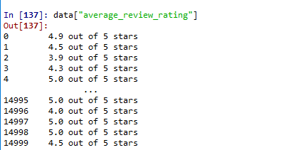
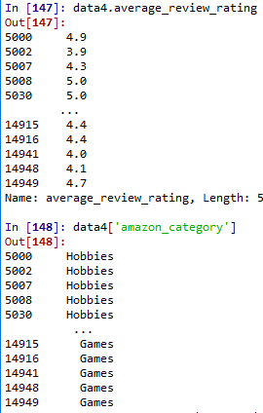
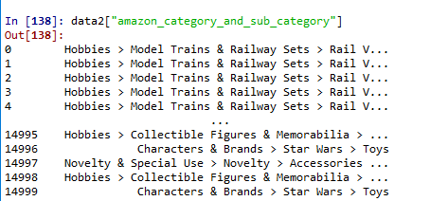
Feature Engineering
Extracted the relevant info for average_review_rating and for amazon_category_and_sub_category from the string values

Slide 15
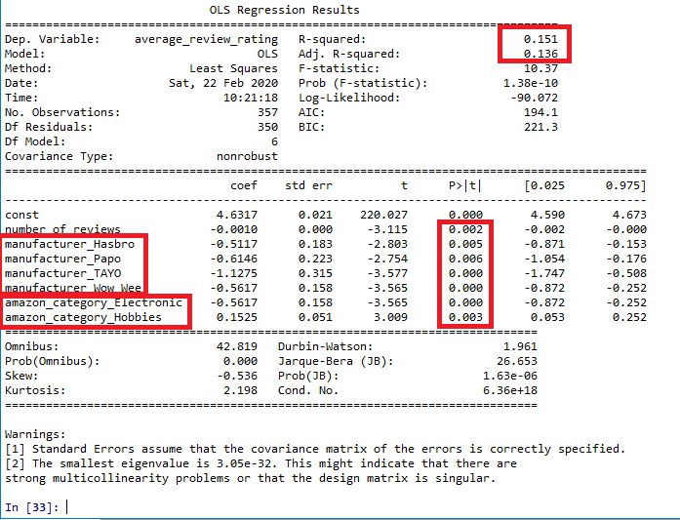
Model Building
Encoded manufacturer and amazon_category and trained and prepared the model using Backward Feature Elimination and ran a Linear Regression model
Findings
Model was not a very accurate model
P-values were small for the manufacturer and categories so there is a high association with the average review ratings
CONCLUSION
Reject the Null Hypothesis that the category and manufacturer do not have effect on the Review rating.

Slide 16
Recommendations
Categorize the new products more as a hobbies and ensure all have a category as several were missing
Continue dealing with the top manufacturers and concentrate on more products from them
Invest more time in testing to check correlation of product name, products description, customer questions and other reviews and how it is worded using NLP

Slide 17
THANK YOU for this opportunity!
alinathani@yahoo.com

